Slide 1
CS 4974 Independent Study
10/24/22 meeting
Student: Bug Lee

Slide 2
Last time, we discussed…
VM demo
Running programs written in custom assembly
Suggestion on how to implement pass by reference

Slide 3
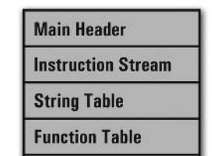
Week 8
compiler
assembler
script.source
script.assembly
script.executable
Virtual Machine
CPU

Slide 4
Parser

Slide 5
Recursive descent
Parse Block
TOKEN_{
Parse
Program
Parse
Statement
Check
1st Token
TOKEN_FUNC
Parse Function
.
.
.
Parse Expression

Slide 6
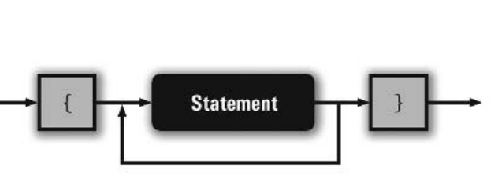
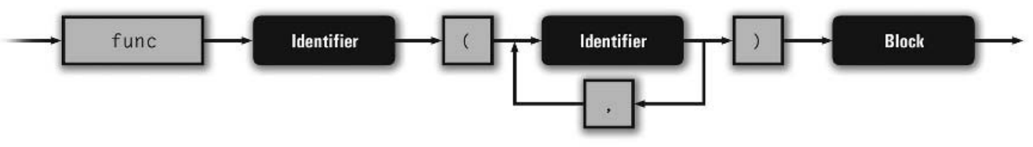
Railroad Syntax Diagram
Block
Function

Slide 7
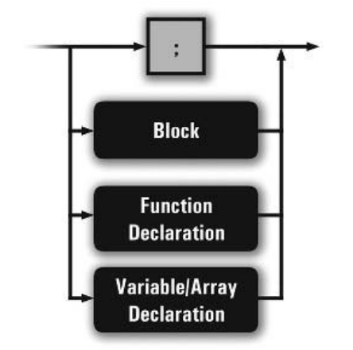
Railroad Syntax Diagram
Statement

Slide 8
Empty statement,
Function,
and variable declaration
Demo

Slide 9
16 + 32 * 2
Expression
Sub-expression
Term
Term
Factor
Factor
Factor
16
32
2

Slide 10
Parsing basic expression
16 + 32 * 2
16
Expression stack
Runtime stack

Slide 11
Parsing basic expression
16 + 32 * 2
+
16
Expression stack
Runtime stack

Slide 12
Parsing basic expression
16 + 32 * 2
32
+
16
Expression stack
Runtime stack

Slide 13
Parsing basic expression
16 + 32 * 2
*
32
+
16
Expression stack
Runtime stack

Slide 14
Parsing basic expression
16 + 32 * 2
2
*
32
+
16
Expression stack
Runtime stack

Slide 15
Parsing basic expression
16 + 32 * 2
64
+
16
Expression stack
Runtime stack

Slide 16
Parsing basic expression
16 + 32 * 2
80
Expression stack
Runtime stack

Slide 17
Basic expression
parsing Demo

Slide 18
Plan for week 9
Continue Compiler parser/code generator implementation.
Parsing full expression
All unary arithmetic and bitwise operators
All binary arithmetic and bitwise operators with parenthesis nesting
Logical and relational operators
Variable and array
Function call

